Slide 1
IIT, Kanpur eMasters – Communication Systems EE922 - Simulation Based Design of 5G NR Wireless Standard
Notes, References, Questions, Problems, and Solutions
Venkateswar Reddy Melachervu
April 2023

Slide 2
Instructor Details
Name: Rohit Budhiraja
E-mail: rohitbr@iitk.ac.in
Phone:
Teaching Assistants

Slide 3
Course Objective
Main Objective
Bridge the gap between the theory and practice of 5G NR wireless communication systems
Consequently bridge the gap between academia and the industry
Teaches
Underlying concepts of 5G NR transceiver blocks
How to read 5G NR standard documents to understand the transceiver specifications
Design and simulate a 5G NR-complaint wireless system in MATLAB

Slide 4
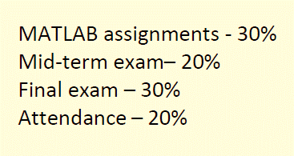
Course Evaluation
From the Lecture Video
Assignment - Matlab Simulation assignments based on class material – 15%
Two mid-term exams – 30%
End-sem - Final exam – 40%
Attendance – 15%
From the First Course Handout in the Portal

Slide 5
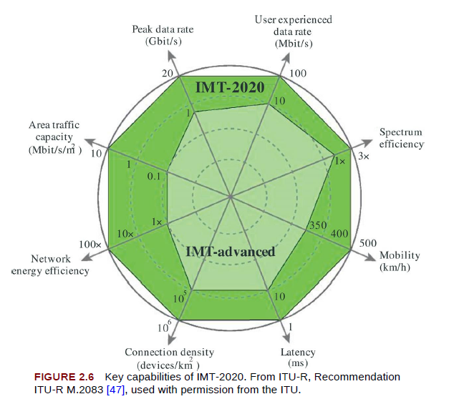
IMT-2020
IMT-2020 Key Capabilities from ITU-R

Slide 6
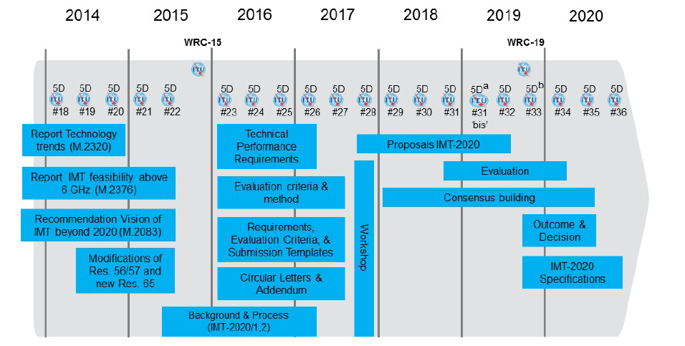
5G Development Timeline

Slide 7
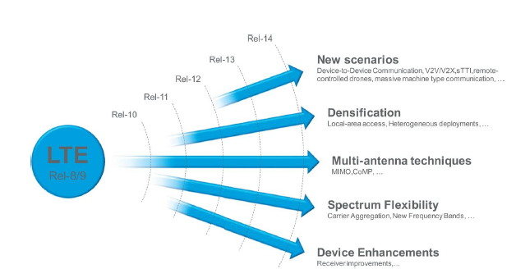
4G LTE to 5G NR
LTE specs – release 8 was introduced in 2009
LTE has evolved from R9 to R14
High data rates with more tx/rx antennae - MIMO
MTC
Reduced air-interface latency from 1 ms (air-frame)
Why NR?
3GPP initiated the new radio access technology known as NR
First version was available in 2017
Reuses many structures and features of LTE
Standardization of mobile communication
Interoperability – devices, services etc.
ETSI, TIA, ARIB, NT
3GPP
WCDMA
Continues to drive 4G (LTE), 5G technologies
LTE – from R8 to R14
5G – R15 – Phase 1
First NR specification was released in Dec 2017
3GPP2
For alternative 3G technology – cdma2000 from IS-95
5G Usage Scenarios
eMBB
mMTC
URLLC
eMBB – Enhanced Mobile Broadband
mMTC – Massive Machine Type Communication
URLLC – Ultra Reliable Low Latency Communication

Slide 8
5G – 3GPP Documents
Documents are divided into releases
LTE is from R8
R15 is new radio
First set in Dec 2017 and full set in mid-2018
Technical specifications are organized in series
38-series: Transceiver design aspects of NR

Slide 9
5G Building Blocks - ETSI
ETSI has a number of component technologies which will be integrated into future 5G systems
Network Functions Virtualization (NFV)
Multi-access Edge Computing (MEC)
Millimetre Wave Transmission (mWT) and
Non-IP Networking (NIN)

Slide 10
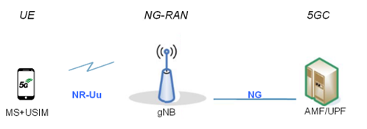
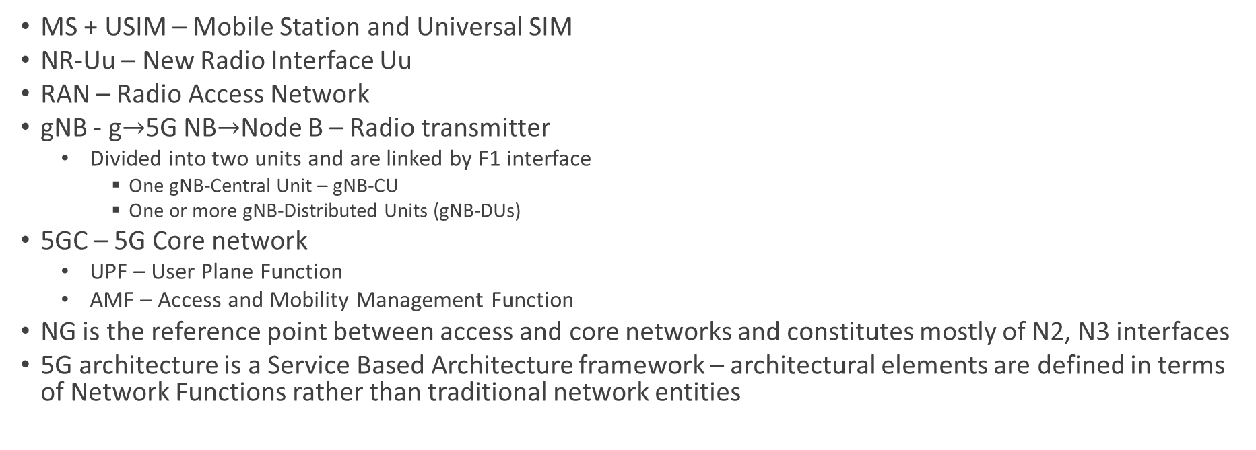
5G Architectural Overview
MS + USIM – Mobile Station and Universal SIM
NR-Uu – New Radio Interface Uu
RAN – Radio Access Network
gNB - g$→$5G NB$→$Node B – Radio transmitter
Divided into two units and are linked by F1 interface
One gNB-Central Unit – gNB-CU
One or more gNB-Distributed Units (gNB-DUs)
5GC – 5G Core network
UPF – User Plane Function
AMF – Access and Mobility Management Function
NG is the reference point between access and core networks and constitutes mostly of N2, N3 interfaces
5G architecture is a Service Based Architecture framework – architectural elements are defined in terms of Network Functions rather than traditional network entities

Slide 11
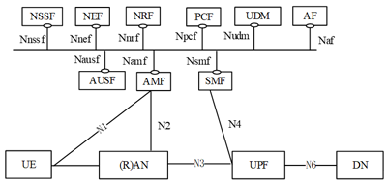
5G Architecture
xx

Slide 12
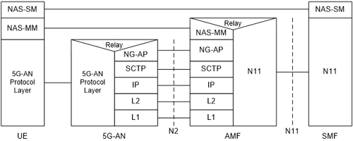
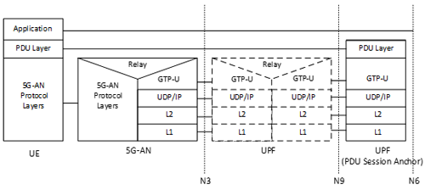
5G Protocol Stacks
xx

Slide 13
5G Frequencies and BWs
For terrestrial, 3 main ranges of frequencies are identified
Up to 1 GHz: with its better propagation characteristics, this set is intended to cover large areas, typically for rural deployment. The maximum bandwidth for one carrier is 100 MHz
From 1 to 6 GHz: this intermediate range is for 5G deployment in a urban or sub-urban context. Here too, the maximum bandwidth is 100 MHz
Higher than 6 GHz: with its poorer propagation but higher bandwidth to the user (maximum bandwidth of 400 MHz), this range is meant for dense urban environment ("hot-spot" type of coverage)

Slide 14
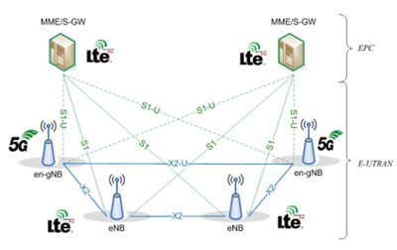
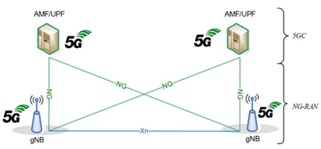
5G – NSA and SA – Non-Standalone and Stand-alone Architectures

Slide 15
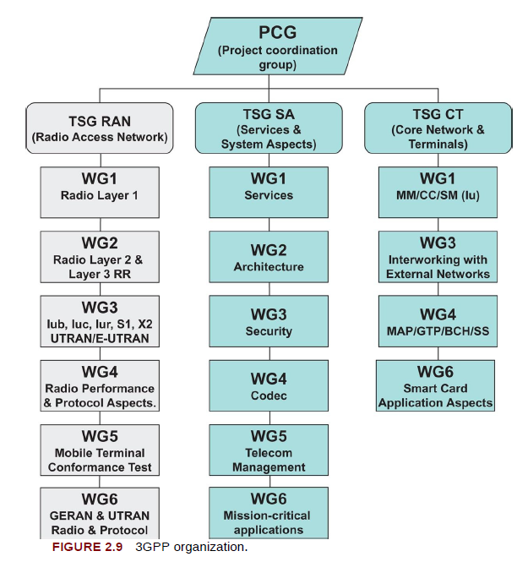
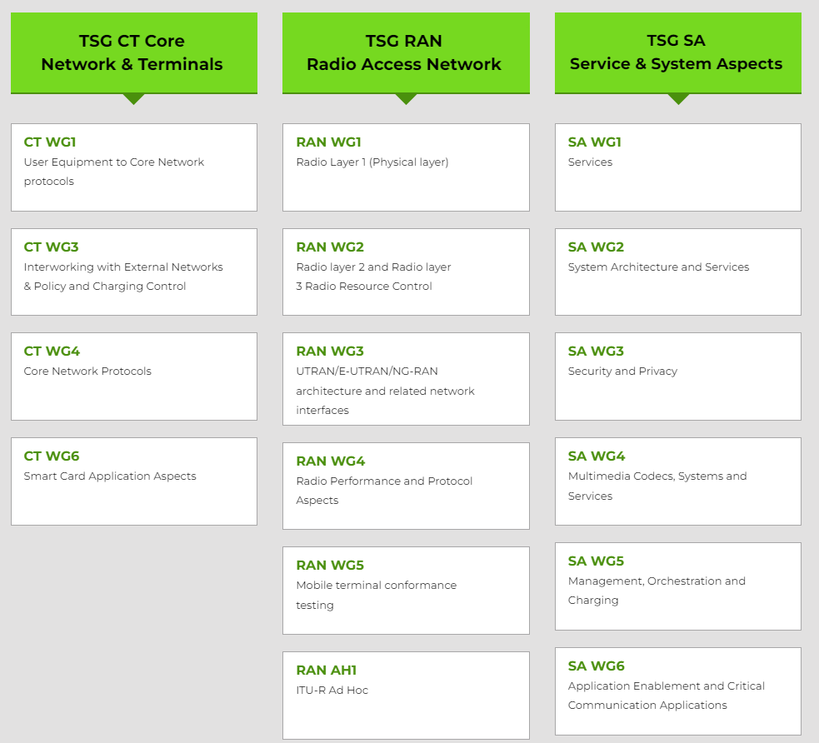
3GPP Organization

Slide 16
3GPP TS
Organized in multiple series – TS XX.YYY
XX – Series number
YYY – Number within the specification
Radio access technologies series
25-Series: Radio aspects of UTRA – WCDMA/HSPA
45-Series: Radio aspects of GSM/EDGE
36-Series: Radio aspects of LTE, LTE-Advanced, and LTE-Advanced Pro
37-Series: Aspects relating multiple radio access technologies
38-Series: Radio aspects for NR
R18 is called 5G-Advanced – the first spec release for 5G Phase 2

Slide 17
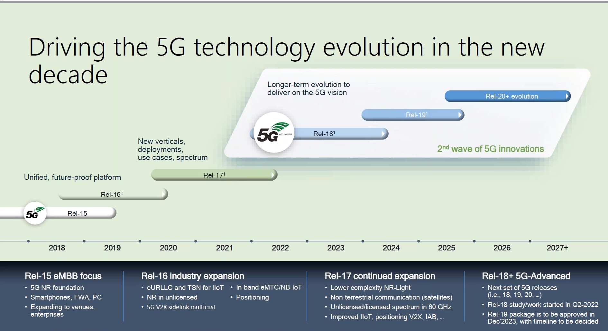
5G Specs Timeline

Slide 18
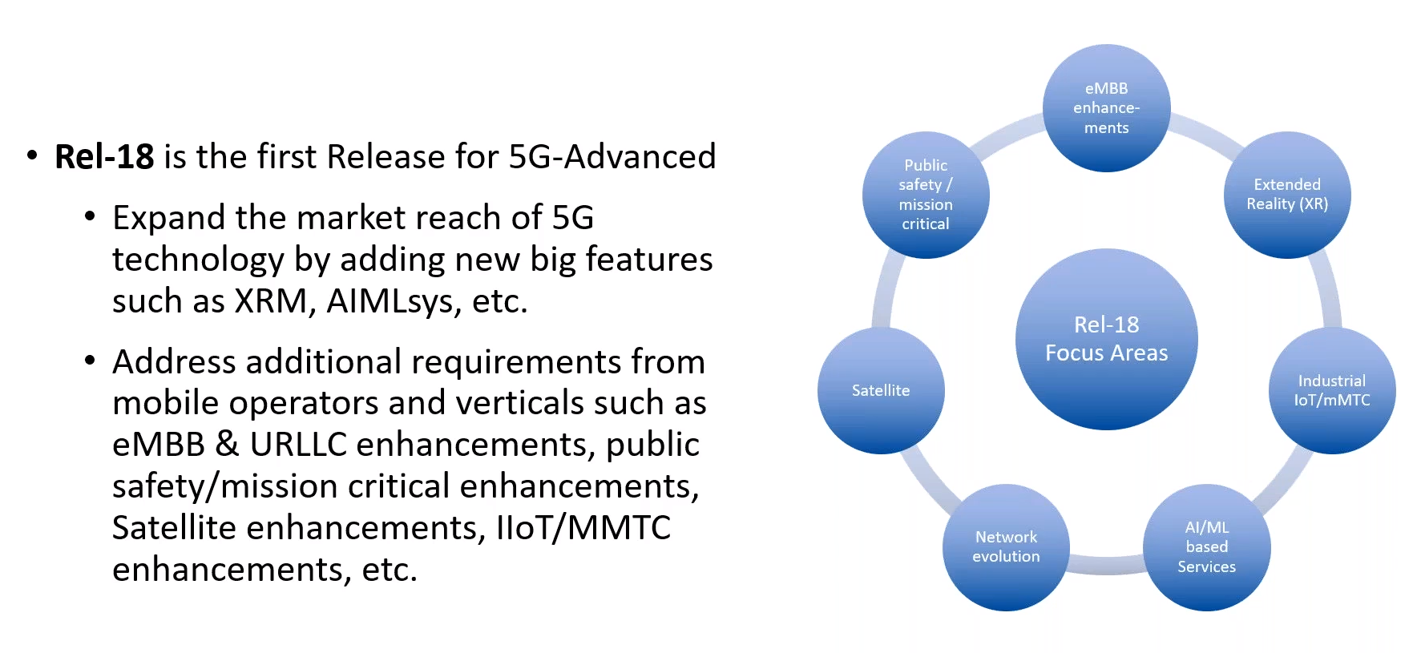
R18 Focus Areas

Slide 19
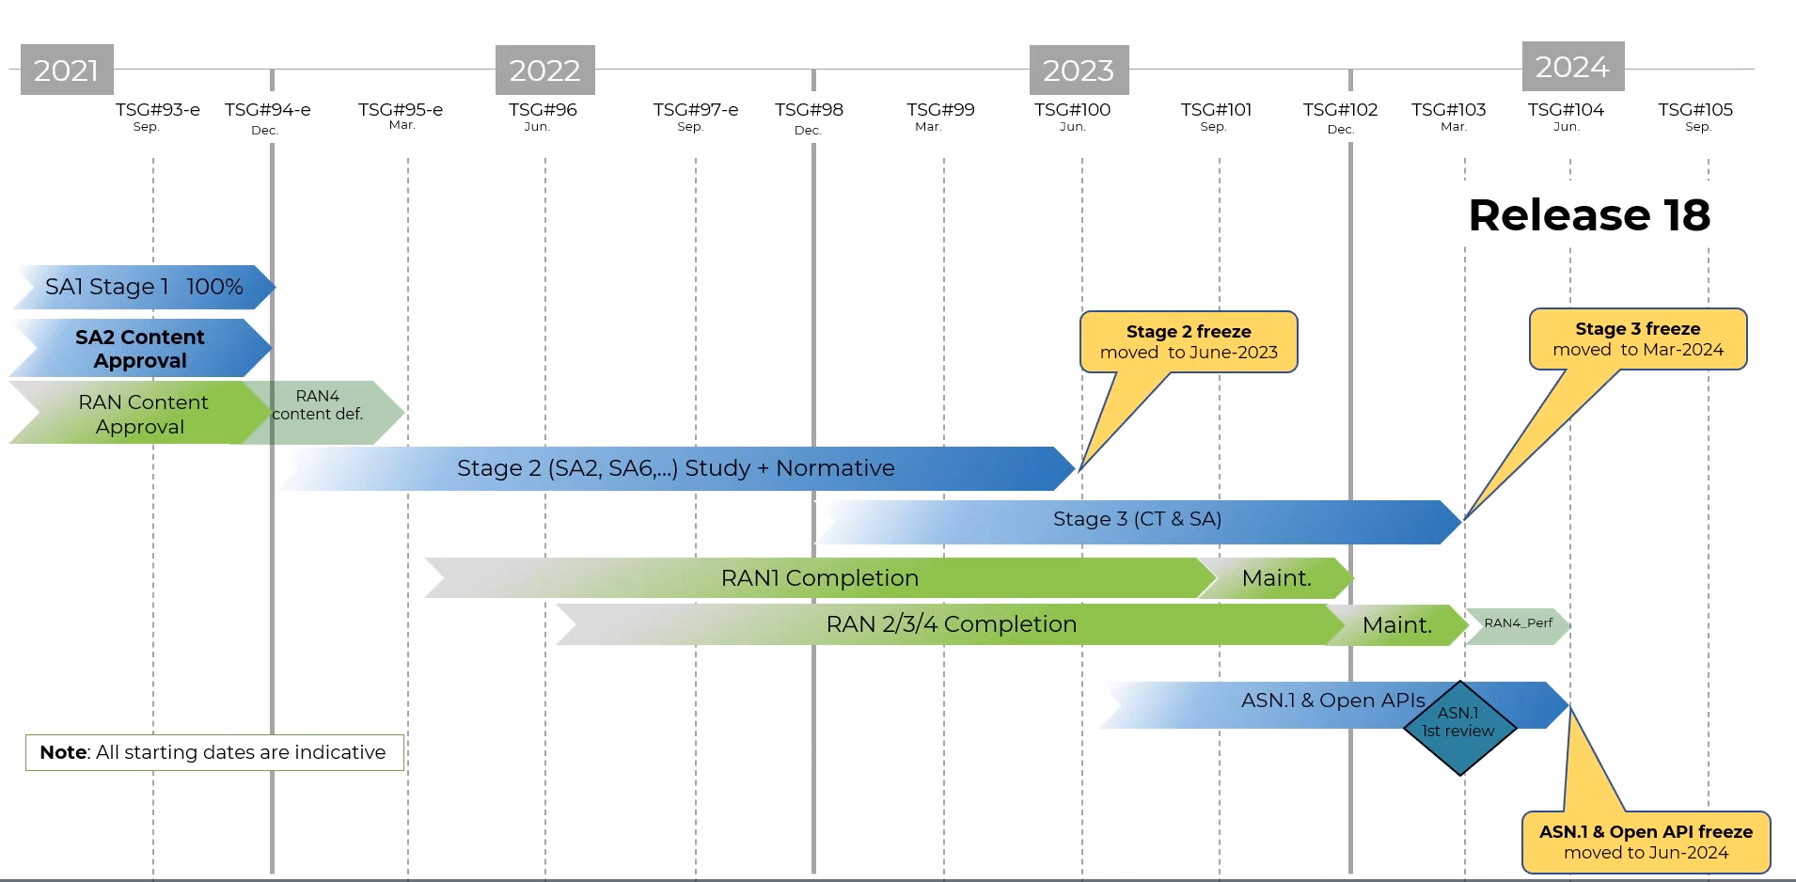
R18 Timeline

Slide 20
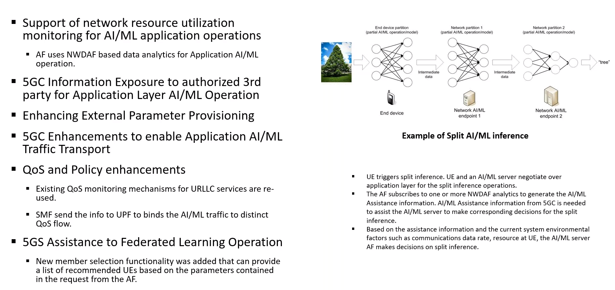
5G Support for AI/ML-based Services

Slide 21
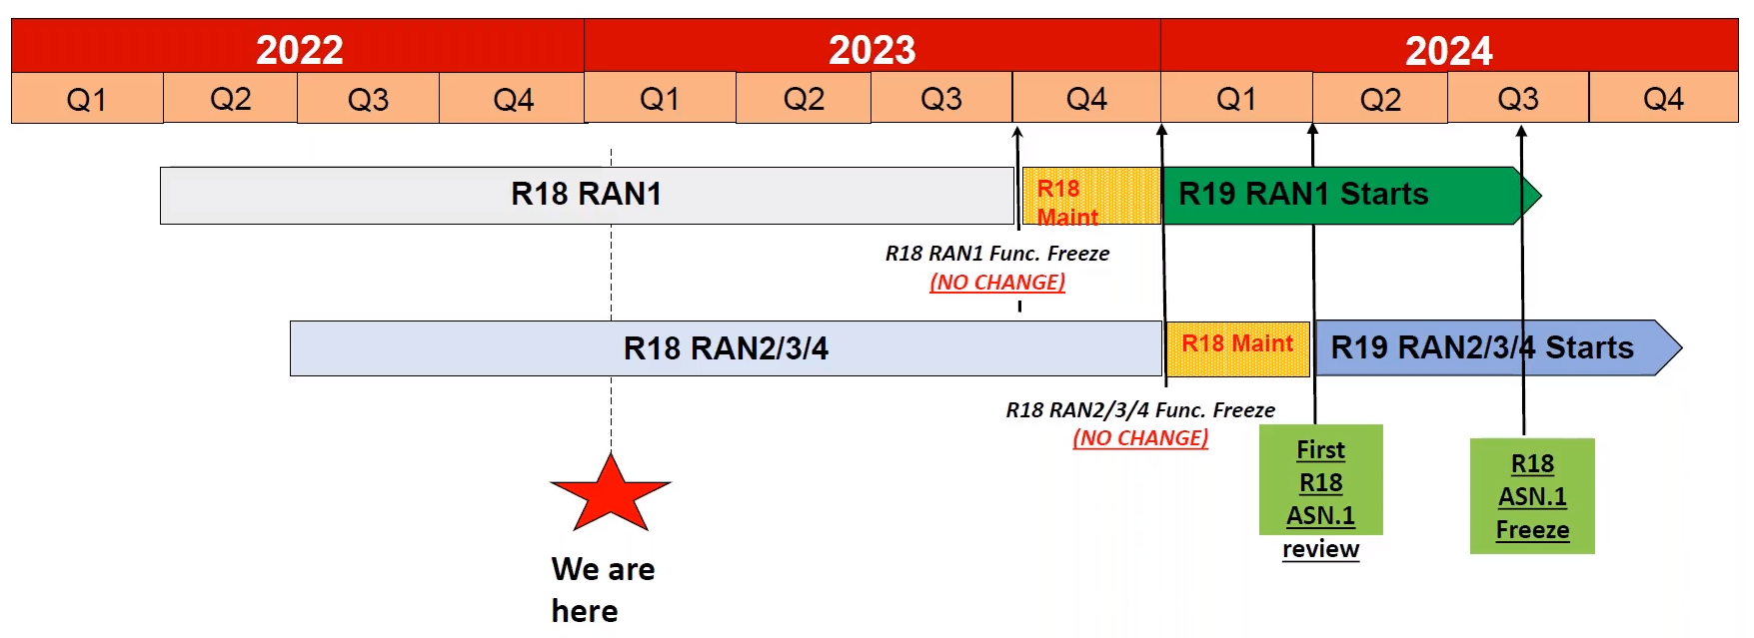
RAN R18 Timeline

Slide 22
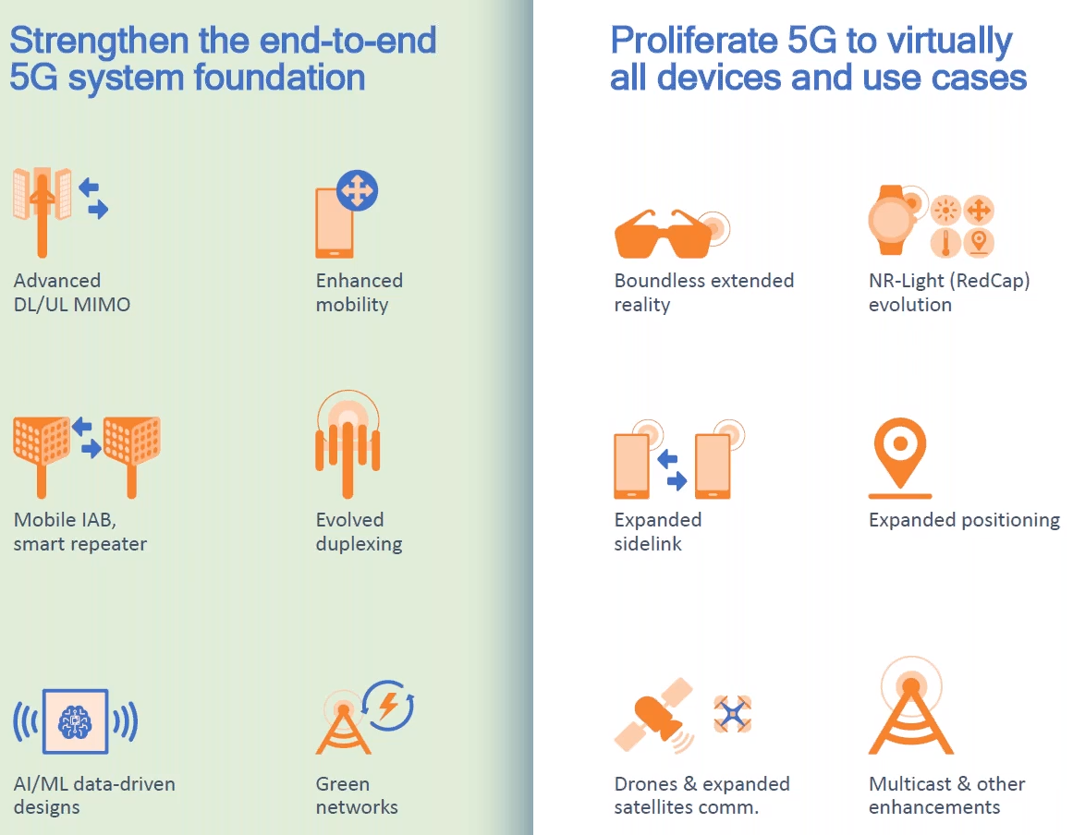
RAN R18 Key Features

Slide 23
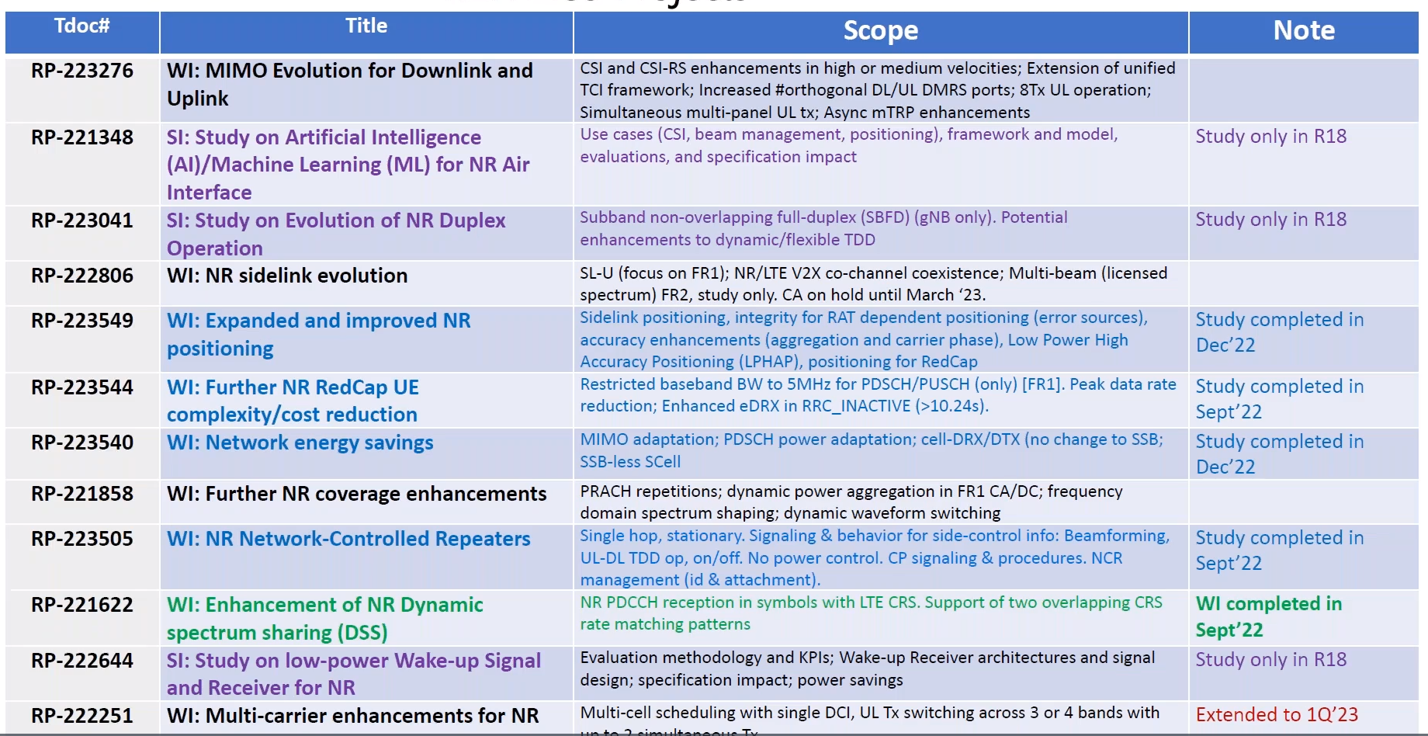
RAN1 Projects/WGs

Slide 24
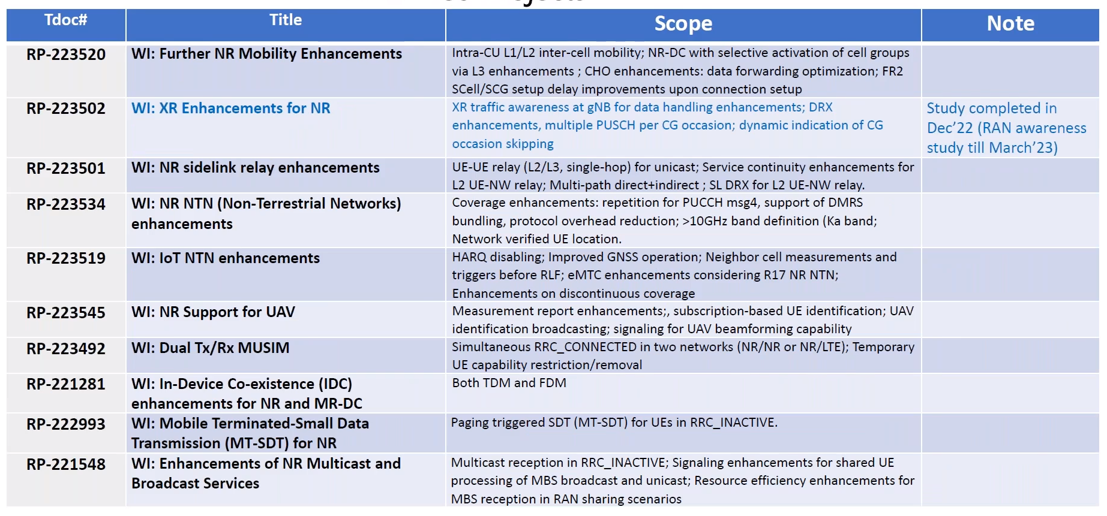
RAN2 Projects WGs

Slide 25
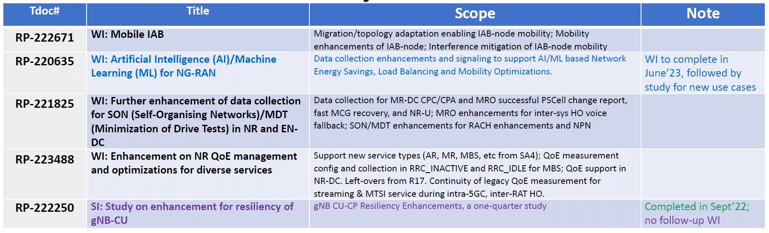
RAN3

Slide 26
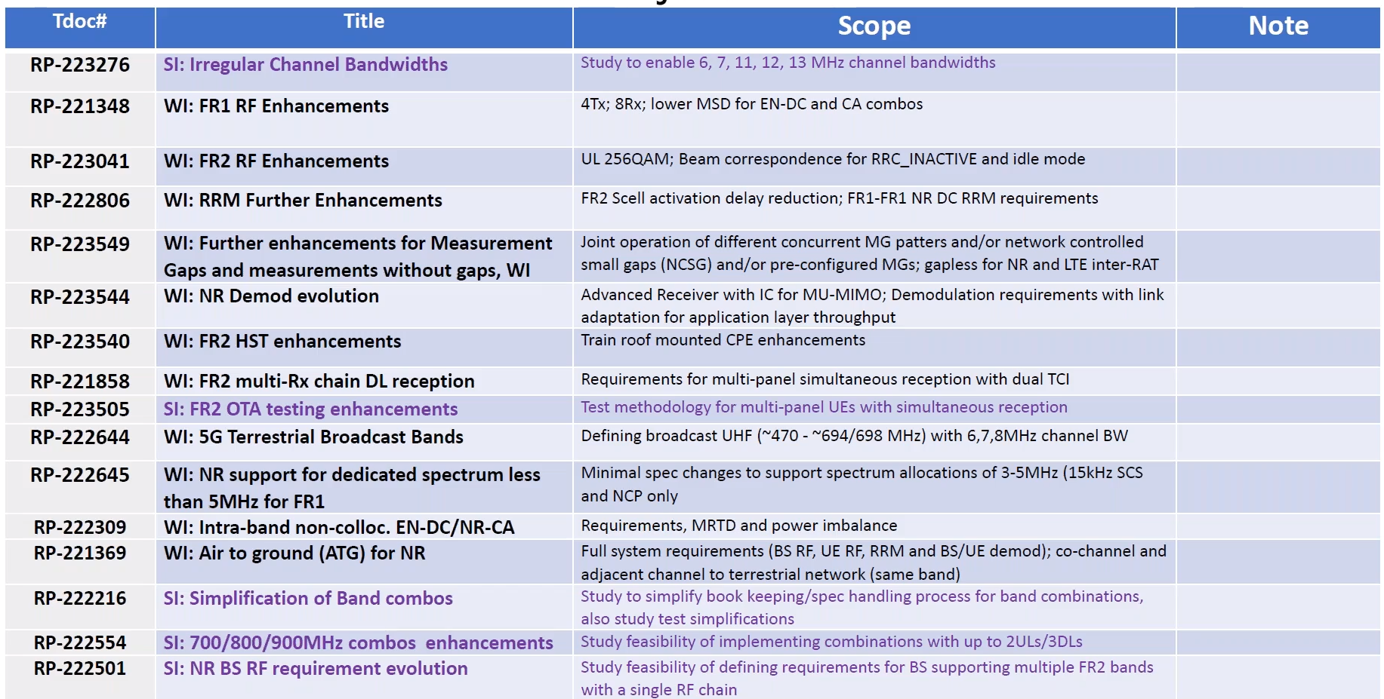
RAN4

Slide 27
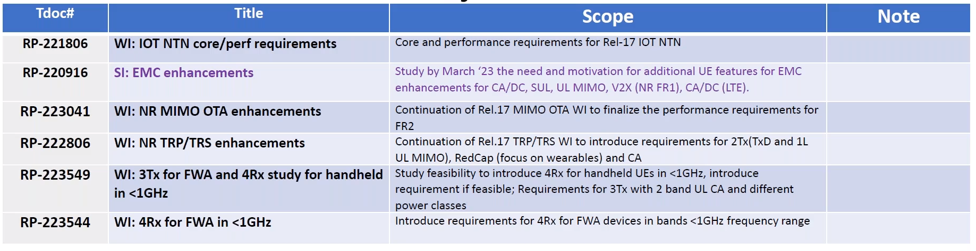
RAN4

Slide 28
3GPP RAN TSG
3GPP Radio Access Network Technical Specification Groups
RAN WG1: Physical Layer
RAN WG2: Layer 2 and Layer 3 Radio Interface
RAN WG3: Fixed RAN Interfaces – interfaces between nodes in RAN and between RAN and Core Network
RAN WG4: RF and Radio Frequency Resource Management – RRM Performance
RAN WG5: Device conformance testing
WG RAN6: Standardization of GSM/EDGE and HSPA

Slide 29
5G Spectrum
1G and 2G – around 800 to 900 MHz
3G – IMT-2000 – 2GHz
3G and 4G operating range – 450 MHz to 6 GHz
Lower frequency bands have good propagation characteristics
Good for wider area deployments – rural and semi-urban areas
Propagation properties of higher frequencies make them difficult to use for wide-area coverage
Boosting bit-rate in dense deployments
5G NR
eMBB – higher data rate and high capacity
Frequency Range – FR1 : Includes all existing and new bands below 6 GHz
FR2 : Includes new bands in the range 24.25 GHz to 52.6 GHz
Frequency bands of NR operates in paired FDD and unpaired TDD spectra
FDD - downlink and uplink operate in different bands
TDD - downlink and uplink operate in same band
Operating bands are numbered n1, n2, n3, etc.
5G – two ranges – up to 6 GHz one and the other 24.25 GHz-52.6GHz
R15 NR specified 26 operating bands in FR1 and 3 in FR2
Frequency Range - FR1 : Includes all existing and new bands below 6 GHz
26 operating bands
Frequency Range - FR2 : Includes new bands in the range 24.25 GHz to 52.6 GHz
3 operating bands
Bands have a numbering scheme ranging from n1 to n512 using the following rules
For NR in LTE re-framing bands, the LTE band numbers are re-used and “n” is added
New bands are assigned following numbers:
Range n65 to n256 are reserved for bands in FR1 – some of these can be used for LTE in addition
Range n257 to n512 are reserved for bands in FR2

Slide 30
Key Technologies of 4G and 5G
Adaptive Modulation and Coding – AMC
OFDM
MIMO
Scheduling and Hybrid ARQ

Slide 31
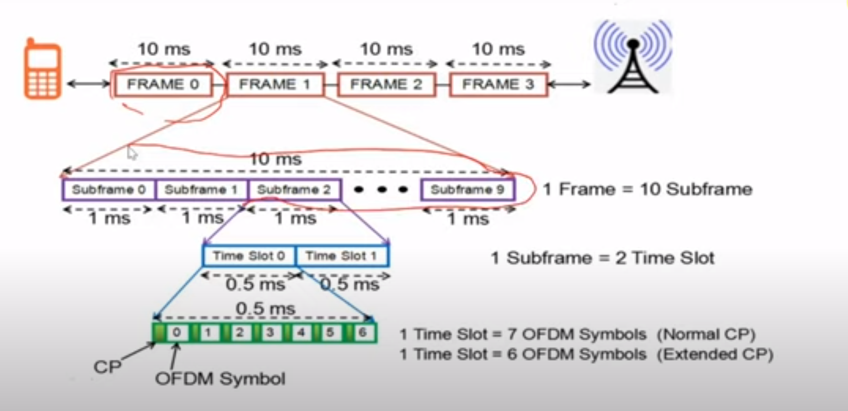
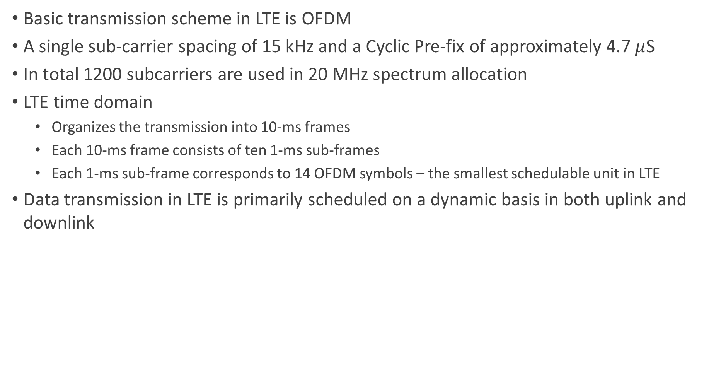
LTE Overview
Basic transmission scheme in LTE is OFDM
A single sub-carrier spacing of 15 kHz and a Cyclic Pre-fix of approximately 4.7 $μ$S
In total 1200 subcarriers are used in 20 MHz spectrum allocation
LTE time domain
Organizes the transmission into 10-ms frames
Each 10-ms frame consists of ten 1-ms sub-frames
Each 1-ms sub-frame corresponds to 14 OFDM symbols – the smallest schedulable unit in LTE
Data transmission in LTE is primarily scheduled on a dynamic basis in both uplink and downlink

Slide 32
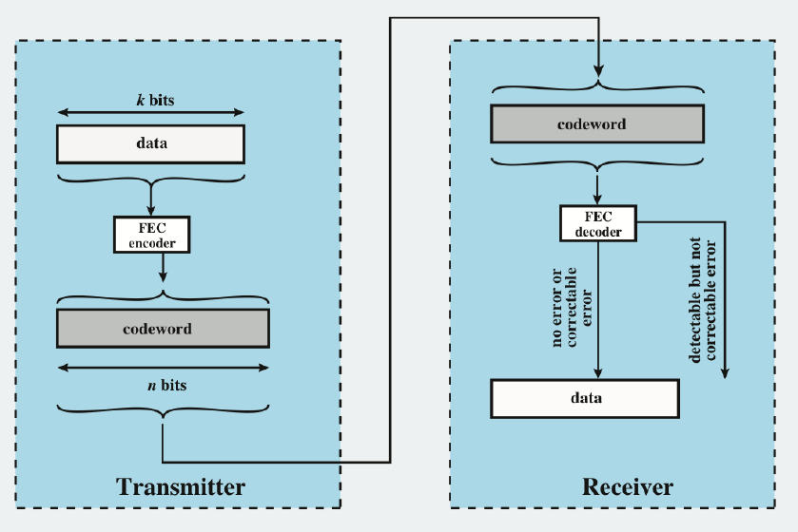
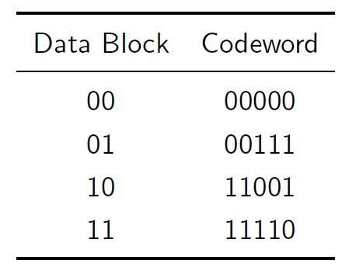
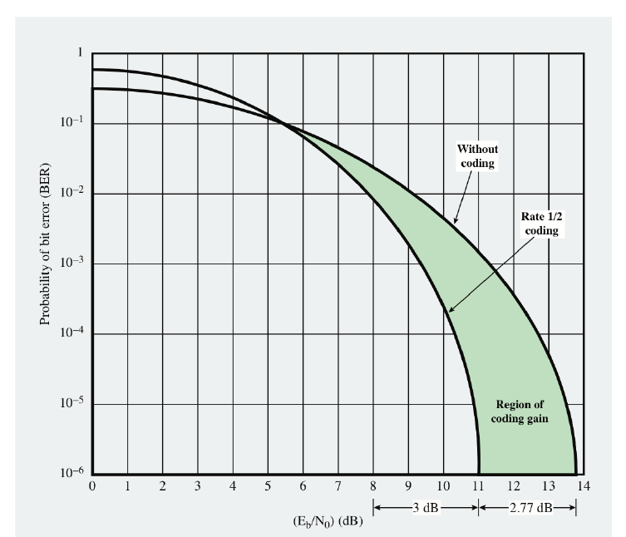
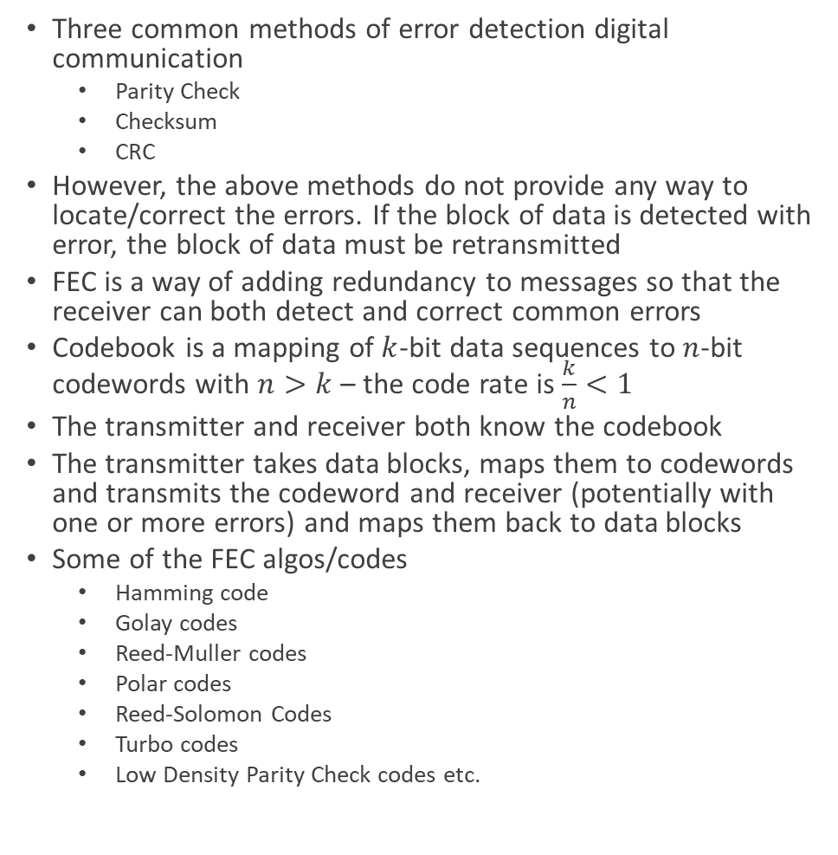
FEC – Forward Error Correction
Three common methods of error detection digital communication
Parity Check
Checksum
CRC
However, the above methods do not provide any way to locate/correct the errors. If the block of data is detected with error, the block of data must be retransmitted
FEC is a way of adding redundancy to messages so that the receiver can both detect and correct common errors
Codebook is a mapping of $k$-bit data sequences to $n$-bit codewords with $n>k$ – the code rate is $\frac{k}{n}<1$
The transmitter and receiver both know the codebook
The transmitter takes data blocks, maps them to codewords and transmits the codeword and receiver (potentially with one or more errors) and maps them back to data blocks
Some of the FEC algos/codes
Hamming code
Golay codes
Reed-Muller codes
Polar codes
Reed-Solomon Codes
Turbo codes
Low Density Parity Check codes etc.

Slide 33
Link Adaption and AMC
Link adaptation is fundamental to the design of radio interface for efficient packet-switched data traffic
The quality of the signal received by the UE depends on:
Channel quality from the serving cell
The level of interference from other cells and
The noise level
To optimize system capacity and coverage for a given transmitted power, the transmitter/NodeB tries to match the information data rate for each user to the variations in the received signal quality – this is commonly referred to as link adaptation and is based on Adaptive Modulation and Coding – AMC
The degrees of freedom for AMC consists of modulation scheme and coding rate
Earlier version of radio access (prior to 5G) - UMTS versions used fast closed-loop power control to support circuit-switched services with roughly constant data rate
However, link adaptation in HSPA (high speed packet access) and in LTE adjust the transmitted information data rate (modulation scheme and coding rate) dynamically to match the prevailing radio channel capacity for each user
Link adaptation is therefore very closely related to the design of the channel coding scheme used for FEC – Forward Error Correction
In LTE, eNodeB typically selects the modulation scheme and code rate (MCS – Modulation and Coding Scheme) depending on a prediction of the downlink channel conditions for the downlink data transmission
An important input to this prediction process is CQI – Channel Quality Indicator – feedback transmitted by the UE in the uplink
CQI is an indication of the data rate which can be supported by the channel taking into account the Signal-to-Interference plus Noise Ratio – SINR and the characteristics of the UE’s receiver
In general, based on CQI, eNodeB can select between:
QPS
16-QAM
64-QAM
And wide range of code rates
eNodeB can directly make its own estimate of the supportable uplink data rate by channel sounding using Sounding Reference Signals – SRSs
Capacity achieving FEC coding used in LTE/4G is Turbo
All cellular systems are designed to achieve capacity and use capacity-achieving FEC codes/coding

Slide 34
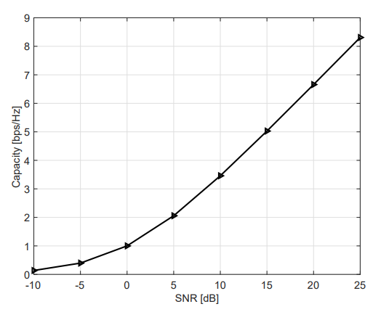
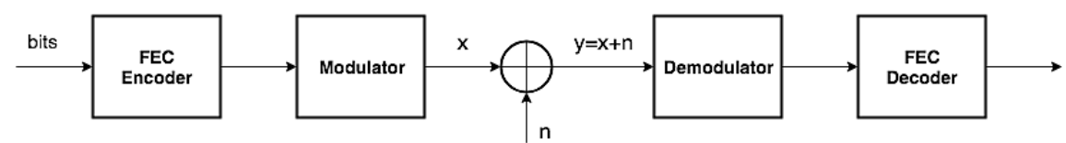
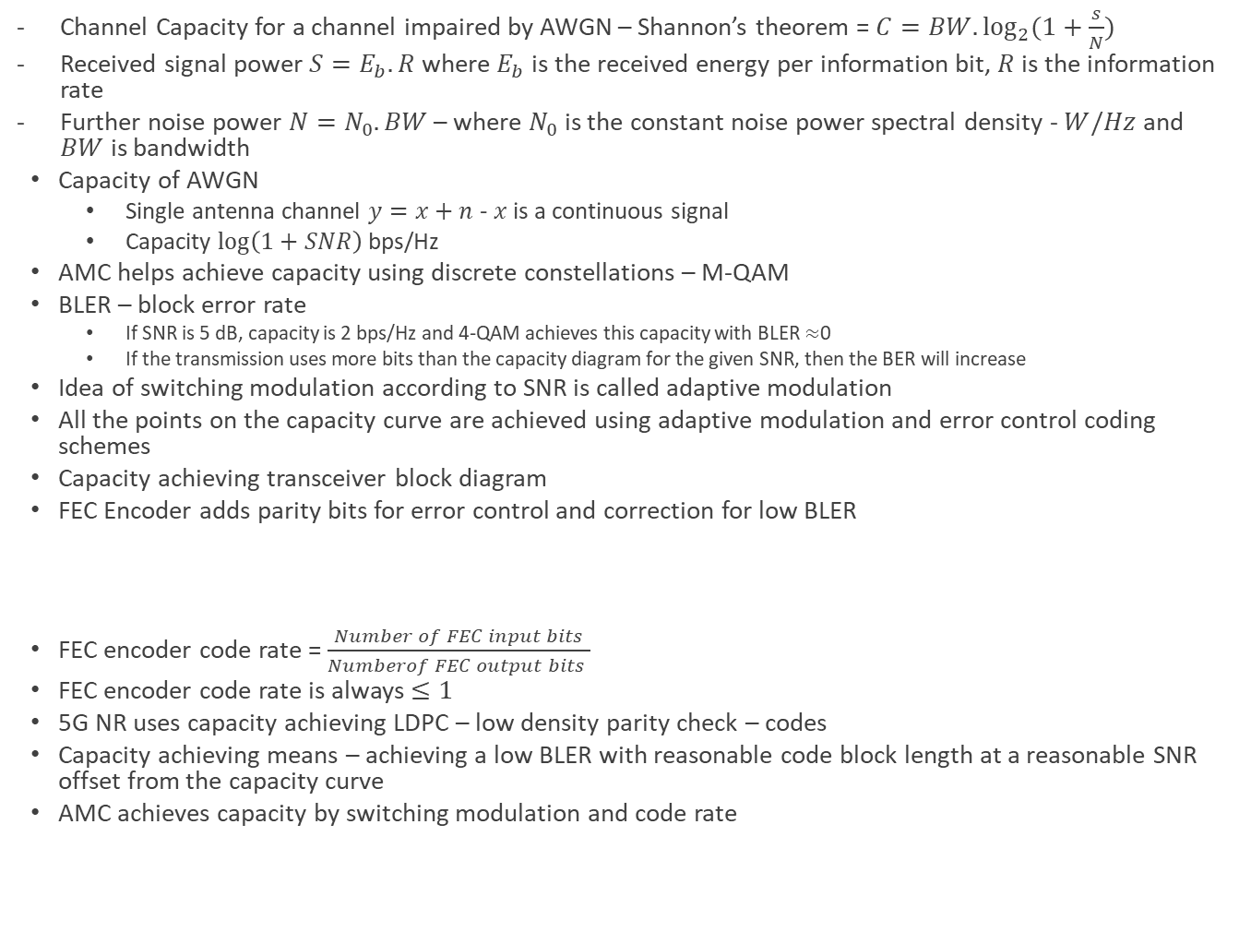
AMC
Channel Capacity for a channel impaired by AWGN – Shannon’s theorem = $C=BW.\log_{2}{(1+\frac{s}{N})}$
Received signal power $S=E_{b}.R$ where $E_{b}$ is the received energy per information bit, $R$ is the information rate
Further noise power $N=N_{0}.BW$ – where $N_{0}$ is the constant noise power spectral density - $W/Hz$ and $BW$ is bandwidth
Capacity of AWGN
Single antenna channel $y=x+n$ - $x$ is a continuous signal
Capacity $\log\left(1+SNR\right)$ bps/Hz
AMC helps achieve capacity using discrete constellations – M-QAM
BLER – block error rate
If SNR is 5 dB, capacity is 2 bps/Hz and 4-QAM achieves this capacity with BLER $≈$0
If the transmission uses more bits than the capacity diagram for the given SNR, then the BER will increase
Idea of switching modulation according to SNR is called adaptive modulation
All the points on the capacity curve are achieved using adaptive modulation and error control coding schemes
Capacity achieving transceiver block diagram
FEC Encoder adds parity bits for error control and correction for low BLER
FEC encoder code rate = $\frac{Number of FEC input bits}{Numberof FEC output bits }$
FEC encoder code rate is always $≤1$
5G NR uses capacity achieving LDPC – low density parity check – codes
Capacity achieving means – achieving a low BLER with reasonable code block length at a reasonable SNR offset from the capacity curve
AMC achieves capacity by switching modulation and code rate
Wireless Channel Spectral Efficiency – Capacity Curve

Slide 35

Question
lec1_5G_spectrum_print →page/slide 11/12 (week-1)
3/4 Code Rate
Modulation and Transmission
How many bits transmitted per second per hertz @SNR 2.5 dB?
2 bps/Hz or 1.5 bps/Hz
3-bits
4-bits
Capacity Curve says @2.5 dB SNR – channel transmission error-free capacity is 1.5 bps/Hz (BLER~0)

Slide 36
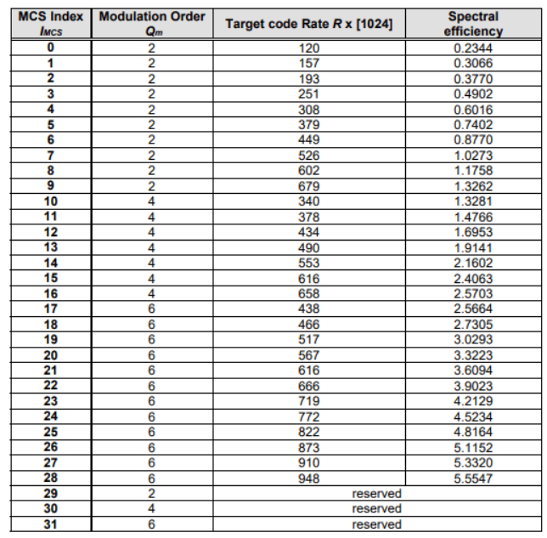
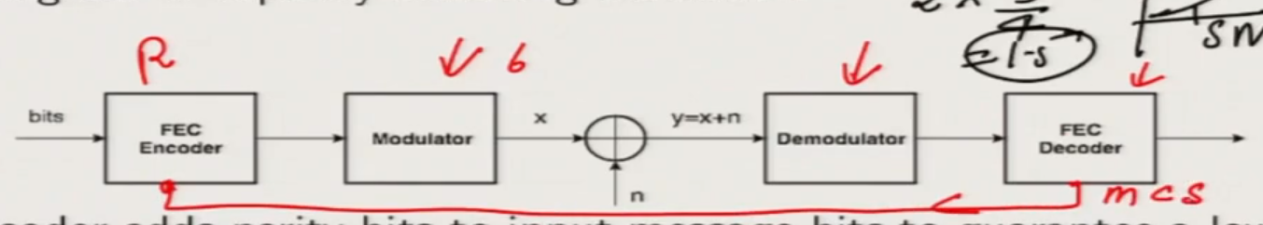
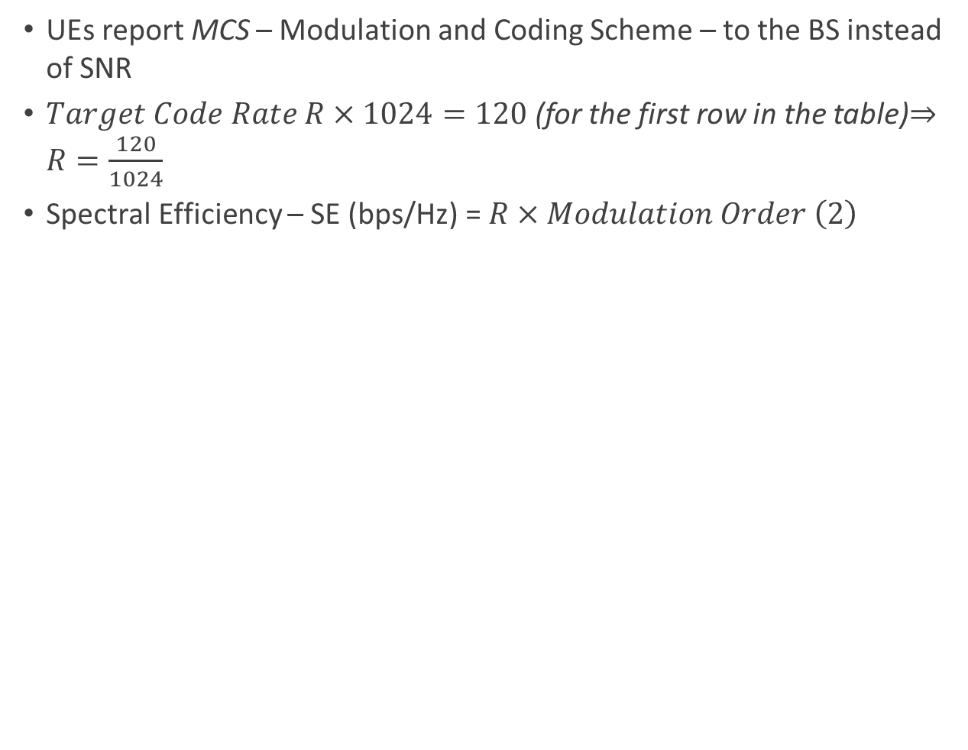
AMC Implementation in 5G
UEs report MCS – Modulation and Coding Scheme – to the BS instead of SNR
$Target Code Rate R×1024=120$ (for the first row in the table)$⇒R=\frac{120}{1024}$
Spectral Efficiency – SE (bps/Hz) = $R×Modulation Order \left(2\right)$
Link Adaptation/AMC – CQI Feedback from UE
MCS – Modulation and Coding Schemes used by UE for CQI

Slide 37
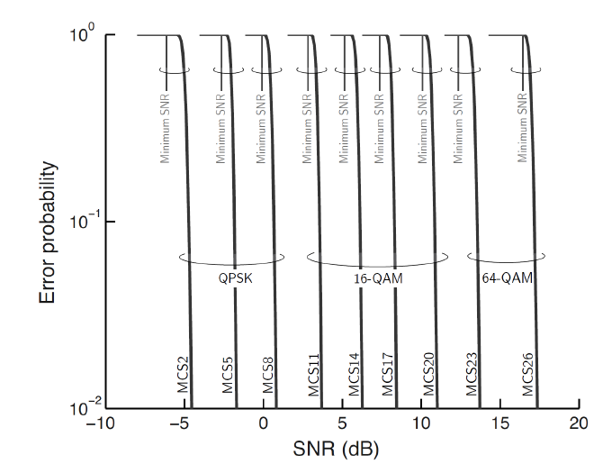
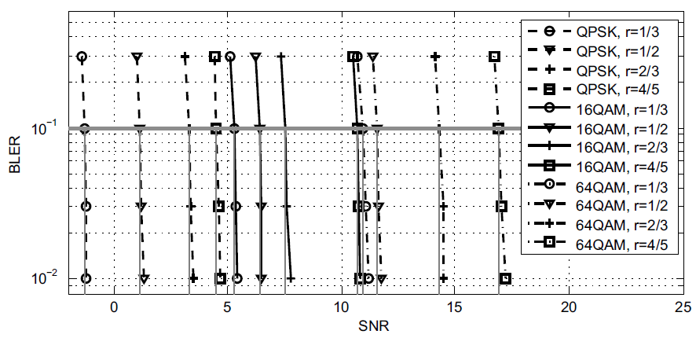
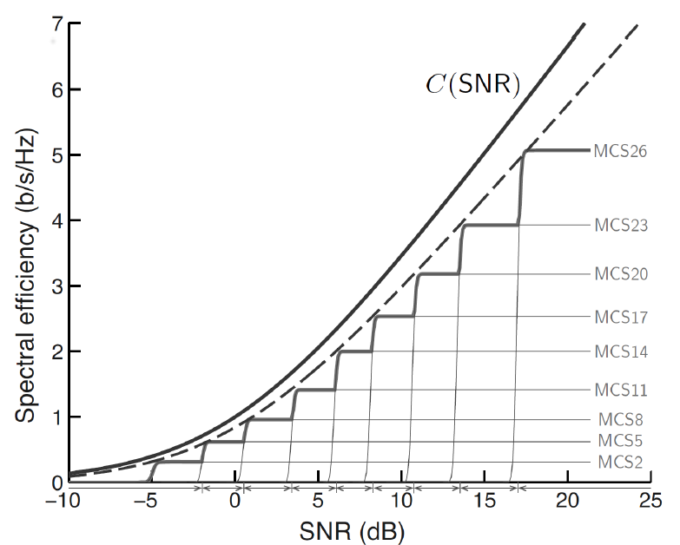
AMC – LDPC and BLER Plot
The marginal SNR offset needed by LDPC
BLER for LDPC Channel Coding
BLER for LDPC Channel Coding – MCS and Modulation Scheme-wise
BLER for LDPC Channel Coding SNR Offsets, MCS, and Against Channel Capacity

Slide 38
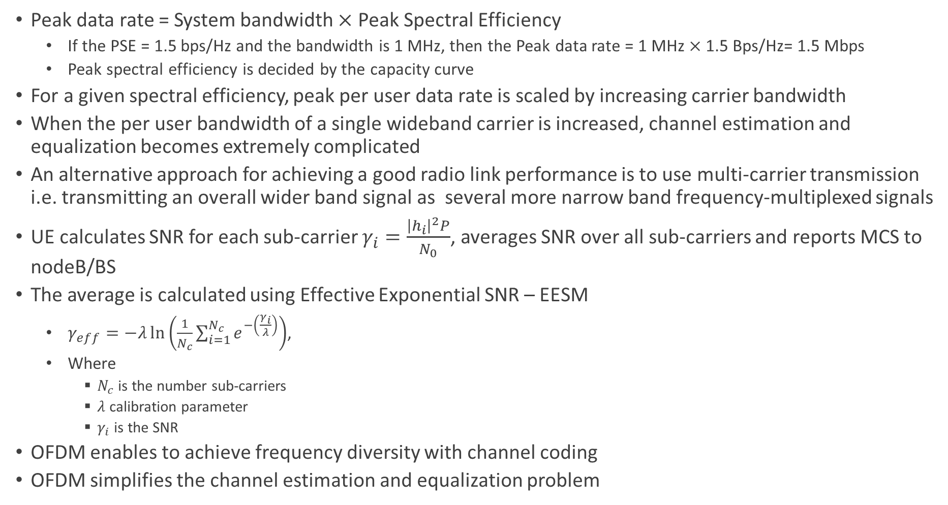
OFDM
Peak data rate = System bandwidth $×$ Peak Spectral Efficiency
If the PSE = 1.5 bps/Hz and the bandwidth is 1 MHz, then the Peak data rate = 1 MHz $×$ 1.5 Bps/Hz= 1.5 Mbps
Peak spectral efficiency is decided by the capacity curve
For a given spectral efficiency, peak per user data rate is scaled by increasing carrier bandwidth
When the per user bandwidth of a single wideband carrier is increased, channel estimation and equalization becomes extremely complicated
An alternative approach for achieving a good radio link performance is to use multi-carrier transmission i.e. transmitting an overall wider band signal as several more narrow band frequency-multiplexed signals
UE calculates SNR for each sub-carrier $γ_{i}=\frac{{\left|h_{i}\right|}^{2}P}{N_{0}}$, averages SNR over all sub-carriers and reports MCS to nodeB/BS
The average is calculated using Effective Exponential SNR – EESM
$γ_{eff}=−λ\ln\left(\frac{1}{N_{c}}\sum_{i=1}^{N_{c}}{e^{−\left(\frac{γ_{i}}{λ}\right)}}\right)$,
Where
$N_{c}$ is the number sub-carriers
$λ$ calibration parameter
$γ_{i}$ is the SNR
OFDM enables to achieve frequency diversity with channel coding
OFDM simplifies the channel estimation and equalization problem

Slide 39
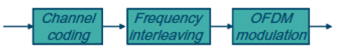
OFDM
OFDM helps in exploiting frequency diversity with channel codidng

Slide 40
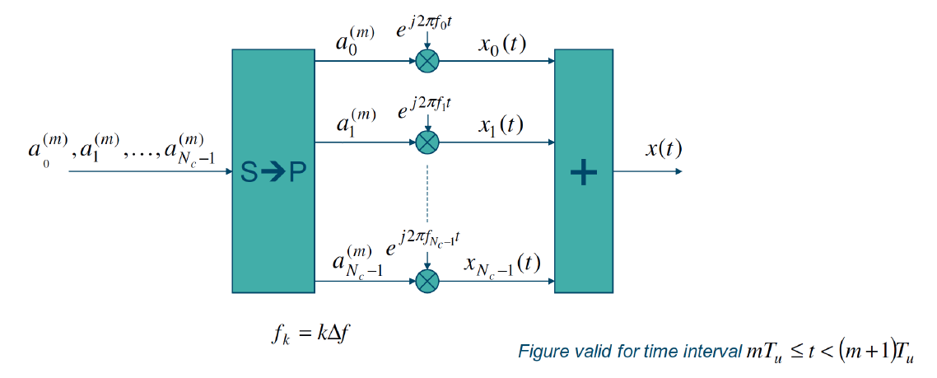
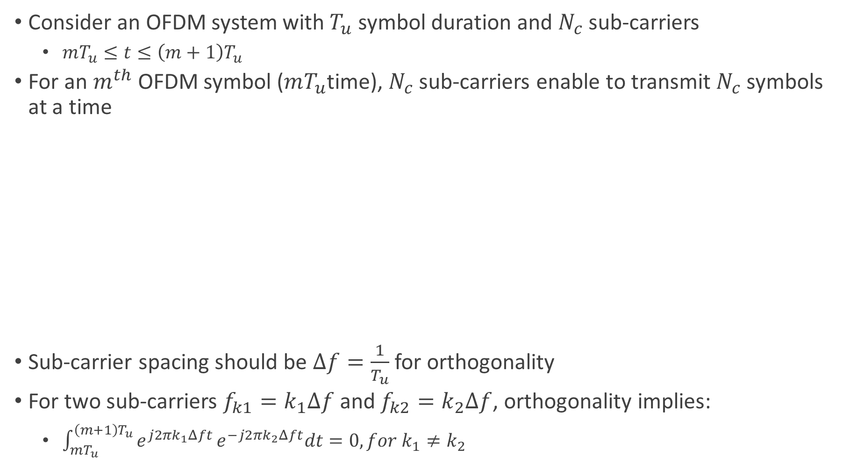
OFDM Transmitter
Consider an OFDM system with $T_{u}$ symbol duration and $N_{c}$ sub-carriers
$mT_{u}≤t≤\left(m+1\right)T_{u}$
For an $m^{th}$ OFDM symbol ($mT_{u}$time), $N_{c}$ sub-carriers enable to transmit $N_{c}$ symbols at a time
Sub-carrier spacing should be $Δf=\frac{1}{T_{u}}$ for orthogonality
For two sub-carriers $f_{k1}=k_{1}Δf$ and $f_{k2}=k_{2}Δf$, orthogonality implies:
$\int_{mT_{u}}^{\left(m+1\right)T_{u}}{e^{j2πk_{1}Δft}}e^{−j2πk_{2}Δft}dt=0, for k_{1}≠k_{2}$

Slide 41
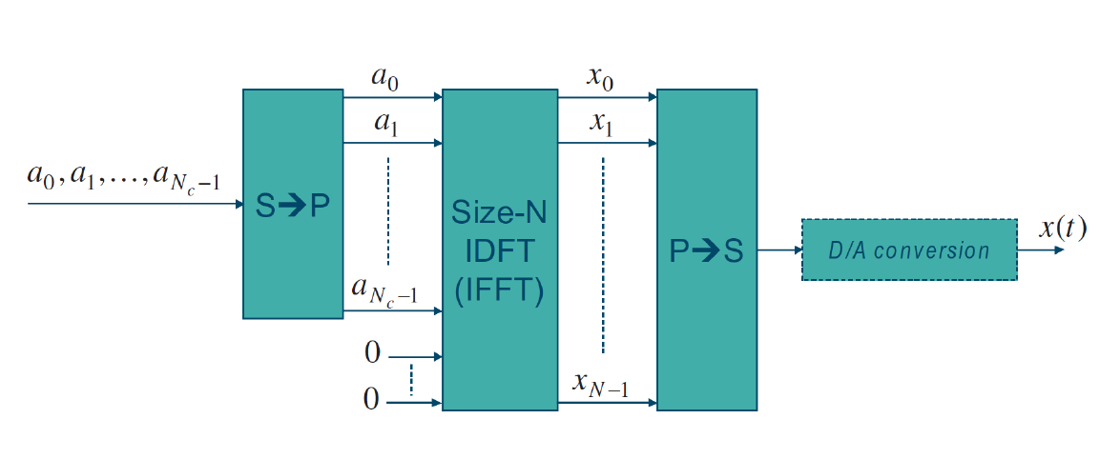
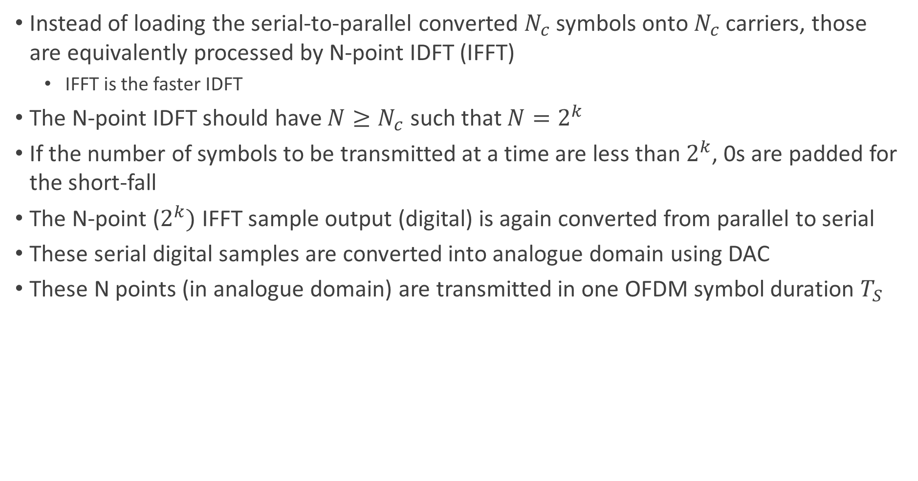
5G-NR Baseband OFDM Transmitter with IFFT
Instead of loading the serial-to-parallel converted $N_{c}$ symbols onto $N_{c}$ carriers, those are equivalently processed by N-point IDFT (IFFT)
IFFT is the faster IDFT
The N-point IDFT should have $N≥N_{c}$ such that $N=2^{k}$
If the number of symbols to be transmitted at a time are less than $2^{k}$, 0s are padded for the short-fall
The N-point ($2^{k})$ IFFT sample output (digital) is again converted from parallel to serial
These serial digital samples are converted into analogue domain using DAC
These N points (in analogue domain) are transmitted in one OFDM symbol duration $T_{S}$

Slide 42
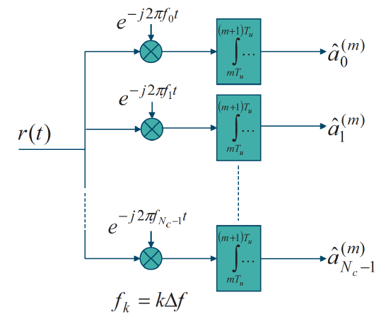
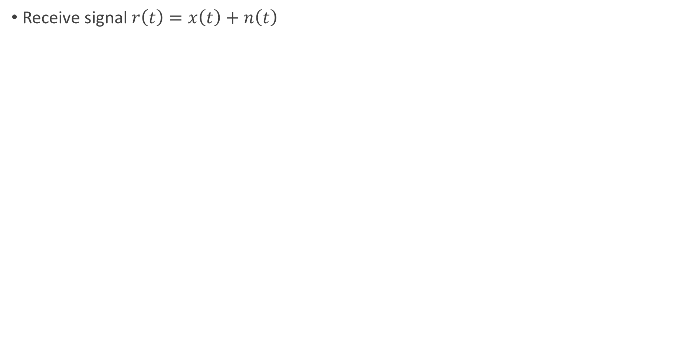
OFDM Receiver
Receive signal $r\left(t\right)=x\left(t\right)+n\left(t\right)$

Slide 43
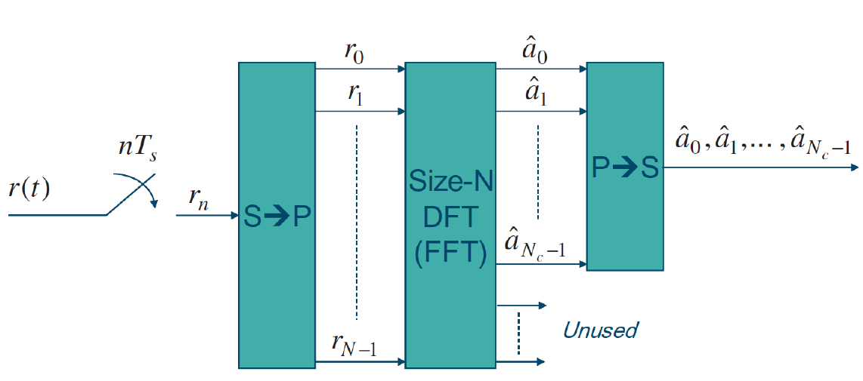
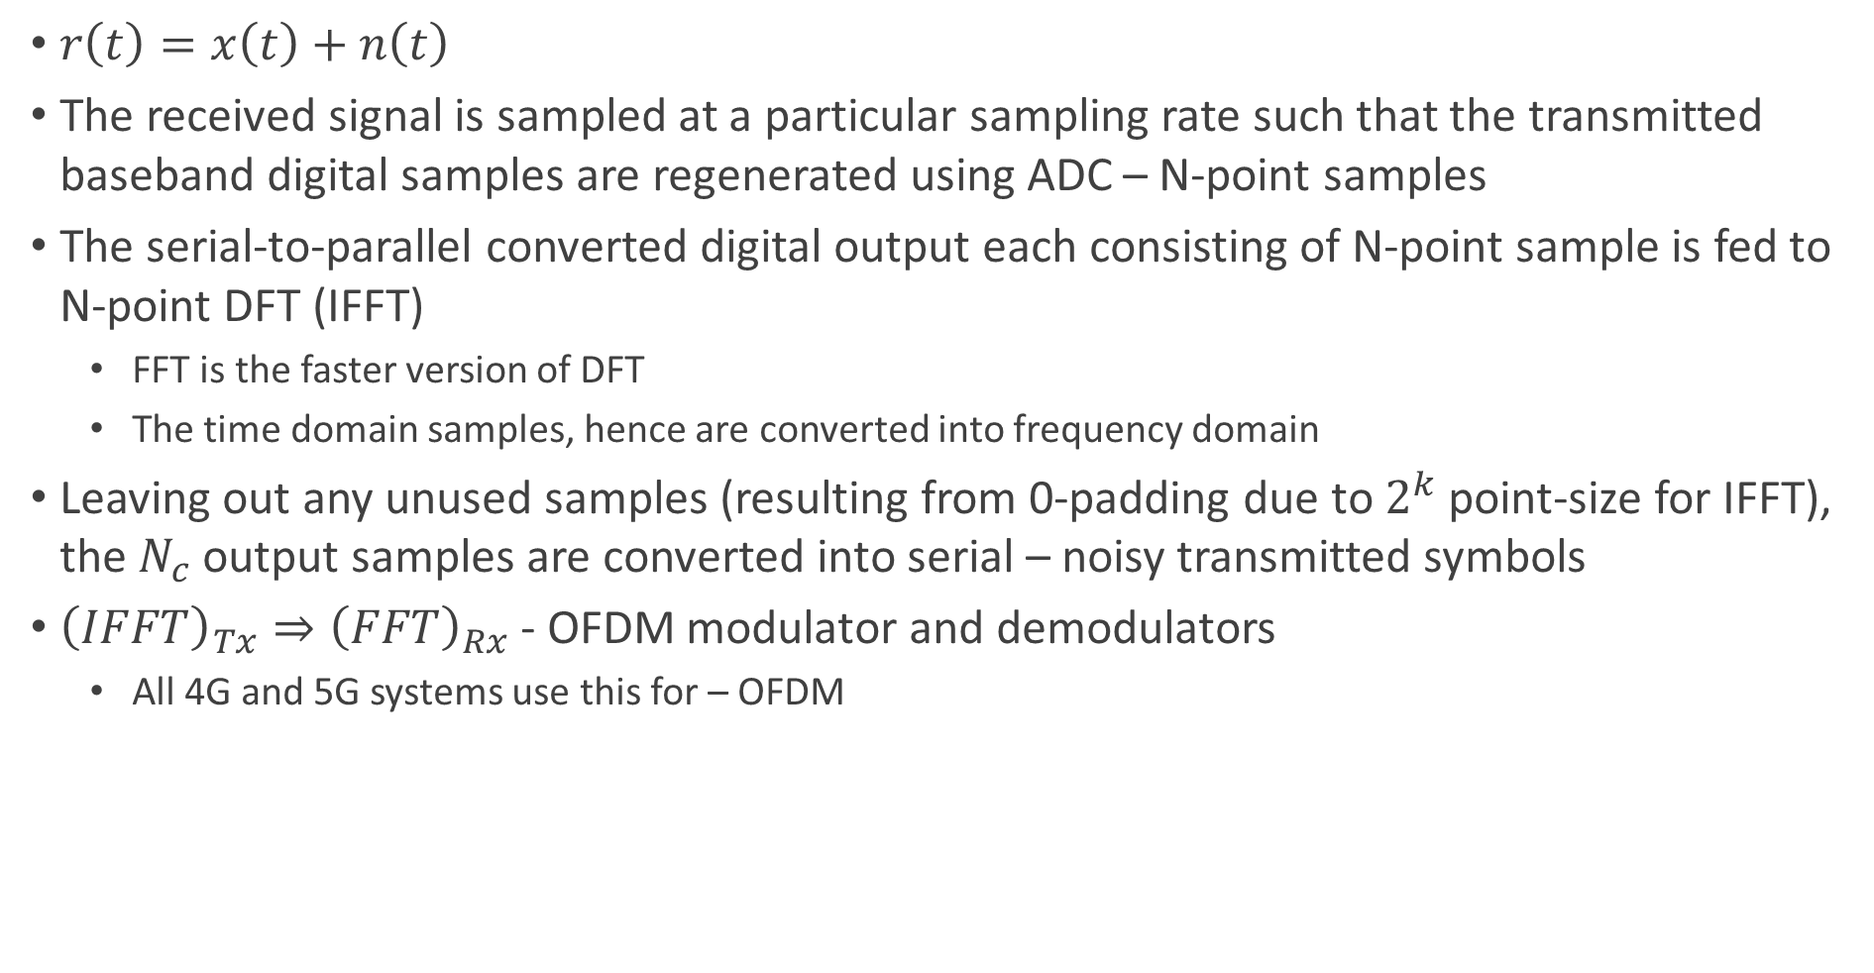
5G-NR Baseband OFDM Receiver with FFT
$r\left(t\right)=x\left(t\right)+n\left(t\right)$
The received signal is sampled at a particular sampling rate such that the transmitted baseband digital samples are regenerated using ADC – N-point samples
The serial-to-parallel converted digital output each consisting of N-point sample is fed to N-point DFT (IFFT)
FFT is the faster version of DFT
The time domain samples, hence are converted into frequency domain
Leaving out any unused samples (resulting from 0-padding due to $2^{k}$ point-size for IFFT), the $N_{c}$ output samples are converted into serial – noisy transmitted symbols
${\left(IFFT\right)}_{Tx}⇒{\left(FFT\right)}_{Rx}$ - OFDM modulator and demodulators
All 4G and 5G systems use this for – OFDM

Slide 44
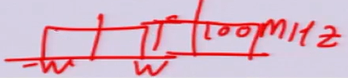


5G-NR System Dimensioning – 100 MHz
NR Baseband BW = 100 MHz ➔ Usable BW = 99 MHz
1 MHz is guard band – 0.5 MHz each side
One of the sub-carrier spacing used in 5G $− Δf=$ 30 KHz
Total sub-carriers required = $\frac{99 MHz}{30 KHz}=3300$
So the nearest $2^{k}$ for 3300 is 4096 and hence (I)FFT size used (N) is 4096 with 0 padding
The OFDM symbol duration $T_{u}=\frac{1}{Δf}=\frac{1}{30 KHz}$
OFDM symbol duration is fixed once the sub-carrier spacing is fixed
Sampling time
We have to send 4096 samples in the symbol duration - $T_{u}$
So $T_{s}=\frac{T_{u}}{4096}$ - inter-symbol sampling
Sampling rate
$F_{s}=\frac{1}{T_{s}}=\frac{4096}{T_{u}}=4096.Δf=4096.30 KHz=122.88 MHz$
Sampling rate required according to Nyquist criteria is 99 MHz
45 MHz is the BW
We are sampling at 122.88 MHz to avoid aliasing effect

Slide 45

5G-NR System Dimensioning – 50 MHz
NR Baseband BW = 50 MHz ➔ Usable BW = 49.5 MHz
0.5 MHz is guard band – 0.25 MHz each side
One of the sub-carrier spacing used in 5G $− Δf=$ 15 KHz
Total sub-carriers required = $\frac{49.5 MHz}{15 KHz}=3300$
So the nearest $2^{k}$ for 3300 is 4096 and hence (I)FFT size used (N) is 4096 with 0 padding
The OFDM symbol duration $T_{u}=\frac{1}{Δf}=\frac{1}{15 KHz}$
OFDM symbol duration is fixed once the sub-carrier spacing is fixed
Sampling time
We have to send 4096 samples in the symbol duration - $T_{u}$
So $T_{s}=\frac{T_{u}}{4096}$ - inter-symbol sampling
Sampling rate
$F_{s}=\frac{1}{T_{s}}=\frac{4096}{T_{u}}=4096.Δf=4096.15 KHz=61.44 MHz$
Sampling rate required according to Nyquist criteria is 49.5 MHz
24.75 MHz is the BW
We are sampling at 61.44 MHz to avoid aliasing effect

Slide 46


OFDM System with Channel
To take care of channel corruption, we add CP – cyclic prefix, a few samples at the end of the sample that get attached at the beginning of the sample
The actual symbol duration becomes $T_{u}+T_{CP}$
System model for data on sub-carriers with channel
$b_{0}=h_{0}a_{0}+n_{0}$
$b_{1}=h_{1}a_{1}+n_{1}$
…
$b_{N_{c}−1}=h_{N_{c}−1}a_{N_{c}−1}+n_{N_{c}−1}$
Noise across sub-carriers is independent

Slide 47



OFDM As Multiple Access Scheme in 5G – Downlink and Uplink
OFDMA - $N_{c}$ sub-carriers are allocated to multiple users in a bunch rather than to a single user for efficient use of bandwidth
Which sub-carrier bunches each user needs to watch out for receiving the data is sent by gNB as control information well in-advance
Two types of sub-carrier allocations for OFDMA – localized and distributed
Localized
Contiguous allocation of sub-carriers per user
Used in the cases of slow movement of users
Distributed
Non-contiguous and distributed allocation of sub-carriers per user
Used in the cases of fast moving users
Channel is changing fast and user cannot measure and send SNR for MCS feedback
Distributes data across non-contiguous sub-carriers hoping to neutralize channel change with the help of LDPC coded data

Slide 48
ARQ Protocol
Receiver (UE) uses an error detection code (like CRC) to check whether a received data block is in error
LDPC is FEC
If no error is detected in the received data block
The received data is declared error-free and
The transmitter is notified via a return channel by ending a positive acknowledgement – ACK
If an error is detected
The receiver discards the received data and
Notifies the transmitter via a return channel by sending a negative acknowledgement – NAK
In response to a NAK, the transmitter retransmits the same information
All modern communication systems including 5G NR, employ a combination of FEC and ARQ
A flavour of the combination is Hybrid ARQ – HARQ

Slide 49

HARQ
Uses FEC codes to correct a subset of all errors and relies on error detection to detect un-correctable errors
Erroneously received data blocks are retained and receiver requests retransmissions of corrupted data blocks
Receiver combines previously received erroneous data and the current retransmitted data for correcting the errors
This procedure is called Hybrid ARQ
Two flavours of HARQ – Chase Combining and Incremental Redundancy
Chase Combining
Only 3 retransmissions are allowed
Incremental Redundancy
xx

Slide 50

Phase Noise
The wave-form drift generated during RF up-conversion in the mixer for the sub-carriers is the phase noise
Phase noise causes inter-carrier-interference (neighbouring signal overlap) if the spacing is not sufficient
This drift or phase shift or interference of the sub-carriers can result in the orthogonality of the sub-carriers being lost
Milli-meter band will have larger phase noise (>28-30 GHz)
Larger phase noise mandates larger sub-carrier spacing to counter it
This drift – phase noise – is bearable below 28 GHz (larger than milli-meter waves)
However, this drift – phase noise – is more pronounced at milli-meter waves demanding larger sub-carrier spacing to counter it
Milli-meter bands are suitable for smaller cell-sizes as the signal decays very fast with distance (higher path loss at higher frequencies) and smaller symbol times (larger sub-carrier spacing) can be used in such cases
Preferred sub-carrier spacing in 5G milli-meter wave systems are 120/240 KHz
Milli-meter systems demand faster processor to deal with the smaller symbol durations – side effect

Slide 51


5G Numerology
5G NR supports scalable sub-carrier spacing = $2^{μ}.15$ KHz, where $μ=0,1,2,3,4$
The combinations of sub-carrier spacing with cyclic prefix supported is termed as 5G NR numerology
5G NR support a wide range of deployment scenarios
Large cells with sub-1 GHz carrier frequency up to mm-wave deployments with wide bandwidths
A single numerology for all the scenarios is not efficient nor possible
Important aspects of OFDM is numerology design – sub-carrier spacing and the CP length
Sub-carrier spacing defines the useful symbol time
For a certain fixed CP length requirement
Relative overhead increases with larger sub-carrier spacing
Smaller CP is preferable from overhead perspective
Larger carrier spacing is beneficial for countering the phase noise at milli-meter carrier frequencies
At milli-meter wave bands, cell site sizes will be smaller and smaller symbol time is necessary for meaningful reception
At FR1, cell sizes can be relatively large (lesser path loss) and a couple of micro-seconds of CP is necessary ➔ a sub-carrier spacing of 15-30 KHz is needed
At FR2, cell sizes will be smaller (hostile channel, higher path losses) and require higher sub-carrier spacing to counter higher phase noise and hence require a smaller CP
Larger the cell, the larger the need for CP to avert ISI
Sub-carrier spacing is primarily selected according to deployment scenario – carrier frequency
FR1 - $Δf −\left\{15 KHz, 30 KHz, 60 KHz\right\}$
FR2 - $Δf −\left\{120 KHz, 240 KHz\right\}$

Slide 52






5G Time Domain Structure
1 Frame – 10 ms
Radio Frame Transmission
1 Sub-frame – 1 ms
#0
#1
#2
#9
Sub-frames
1 slot
14 Symbols
14 Symbols
14 Symbols
14 Symbols
Slots
$$Δf=240 KHz$$
1 Slot – 0.0625 ms
$$Δf=120 KHz$$
1 Slot – 0.125 ms
$$Δf=60 KHz$$
1 Slot – 0.25 ms
$$Δf=30 KHz$$
1 Slot – 0.5 ms
$$Δf=15 KHz$$
1 Slot – 1 ms
5G NR transmissions are organized into frames of 10 ms duration
Frames are sub-divided into equal-sized sub-frames of 1 ms duration
A sub-frame is formed by one or multiple adjacent slots, each slot having 14 adjacent OFDM symbols
A sub-frame is further divided into slots consisting of 14 OFDM symbols each
1 slot = 14 OFDM symbols
Slots per sub-frame will vary based on the numerology chosen
Higher sub-carrier spacing leads to a shorter slot duration and can be used to support lower-latency transmission
Duration of a slot in milli-seconds depends on the numerology
Slot is a typical dynamic scheduling unit
Sub-frame duration in 5G NR serves as a numerology-independent time reference and remains same
A mini-slot, in principle, can be as short as one OFDM symbol
In release 15, mini-slots are restricted to 2,4, and 7 OFDM symbols
Time duration of a slot/mini-slot scales with the chosen numerology (sub-carrier spacing) since the duration of OFDM symbol is inversely proportional to its sub-carrier spacing
CP shrinks with increasing sub-carrier spacing
Reducing slot duration is a less efficient way of providing low latency communication

Slide 53

5G Time Domain Structure
Sub-carrier Spacing - $Δf$ | Useful Symbol Time - $T_{u}$ | Cyclic Prefix - $T_{CP}$ | OFDM Symbol Time - $T_{u}+T_{CP}$ | 14 OFDM Symbols Time | Number of Slots in Sub-frame | CP Overhead
15KHz | 66.7$μs$ | 4.7$μs$ | 71.4$μs$ | 14*71.4=999.6$μs$ | 1 | Around 7%
30KHz | 33.3$μs$ | 2.3$μs$ | 35.6$μs$ | 14*35.6=498.4$μs$ | 2
60KHz | 16.7$μs$ | 1.2$μs$ | 17.9$μs$ | 14*17.9=250.6$μs$ | 4
120KHz | 8.33$μs$ | 0.59$μs$ | 8.92$μs$ | 14*8.92=124.88 | 8
240KHz | 4.17$μs$ | 0.29$μs$ | 4.46$μs$ | 14*4.46=62.44$μs$ | 16

Slide 54
5G Time Domain Structure - Detailed
Let’s take a 100 MHz system as an example
(I)IFFT size N=4096

Slide 55

Physical Time-Frequency Resources
Physical time-frequency resources correspond to the OFDM symbols and sub-carriers within the OFDM symbols
Smallest physical time-frequency resource consists of one sub-carrier in one OFDM symbol known as Resource Element
Transmissions are scheduled in group(s) of 12 sub-carriers known as Physical Resource Blocks – PRBs
In the time domain. The radio transmissions are organized into:
Radio frames→sub-frames→slots→mini-slots
Physical layer uses time-frequency resources for transmission
In NR, the time-frequency resources (resource elements) represent either physical channels or physical signals
In 3GPP terminology, a physical channel corresponds to a set of resource elements carrying information originating from higher layers above PHY
Whereas a physical channel (used by physical layer) corresponds to a set of resource elements that do not contain information from higher layers

Slide 56
Physical Channels
Time-frequency resource carrying information from layers above PHY are termed physical channels
The uplink and downlink physical channels are:
PDSCH - Physical downlink shared channel used for downlink data transmission
Control information is MCS index
PDCCH – Physical downlink control channel used for downlink control information
Scheduling decisions required for downlink data (PDSCH) reception
Scheduling grants giving permission for uplink data (PUSCH) transmission by a UE
PBCH – Physical broadcast channel used for broadcasting system information required by a UE to access the network
PUSCH – Physical uplink shared channel used for uplink data transmission by a UE
PUCCH – Physical uplink control channel used for uplink control information
HARQ feedback acknowledgements – indicating whether a downlink transmission was successful or not
Scheduling request for time-frequency resources from the network for uplink transmissions
Downlink channel-state information for link adaptation
PRACH – Physical random access channel used by a UE to request connection setup referred to as random access
To enable ultra-low latency communication, the network can also pre-configure data transmission resources for a UE to avoid the signalling involved in sending scheduling request and scheduling grants – this is known as grant-free transmission

Slide 57
Physical Signals
The time-frequency resources that are used by the PHY layer but do contain information from higher layers above PHY are termed as physical signals
The physical signals are used for different purposes
Demodulation
Channel estimation
Synchronization
Channel state information
Different physical signals in uplink and downlink are
Downlink
DM-RS – Demodulation reference signal
PT-RS – Phase tracking reference signal
CSI-RS – Channel state information reference signal
PSS – Primary synchronization signal
SSS – Secondary synchronization signal
Uplink
DM – Demodulation reference signal
PT-RS – Phase tracking reference signal
SRS – Sounding reference signal
In contrast to LTE setup, the reference signals in 5G NR are transmitted only when necessary

Slide 58
5G Protocol Architecture
Service data adaptation layer
SDAP
QoS management
Packet data convergence layer
PDCP
Encryption to secure data
Radio link control layer
RLC
Duplicate detection
Medium access layer
MAC
Hybrid ARQ, retransmission, uplink/downlink scheduling
Physical layer
PHY
Coding, decoding, modulation, demodulation, multi-antenna processing

Slide 59

5G MAC-PHY Interface – gNB and UE
MAC layer will pass data and control to PHY to process
Control information
MCS index – Modulation and coding scheme
The data payload aka transport block from MAC needs to be processed by PHY for
Encode at a particular rate
Mapped/modulated using the modulation scheme – 4/16/64/256-QAM – adaptive modulation and coding - AMC
MAC can pass over two independent data blocks and control data to PHY layer
For enabling MIMO transmission
Data payload in 5G is carried on PDSCH
Control information is carried on PDCCH
Block sizes
Minimum – for MCS-0 and 1RB – 24 bits
1 RB = 12 OFDM sub-carriers
There are totally 3300 usable sub-carriers and 4096 FFT points
So maximum RBs = 3300/12=275
Maximum – for MCS-27 and 275 RBs – 319784
At PHY layer, 24/16 bit CRC is attached to the transport block
CRC performs error detection and does NOT perform error correction – FEC performs error correction
An n-bit CRC applied to a data block of arbitrary length will detect any single error burst of length n bits or less
CRC is essential for HARQ

Slide 60

CRC Calculation and Algorithm
Transport block is treated by the CRC algo as a binary number
The transport block is padded with zeros as per the CRC check-sum bits
The padded transport block is divided (modulo-2) by another binary number called Generator Polynomial
Generator polynomial form is $D^{2}+1$ denoted as 101
The degree or order of the polynomial is 2
CRC length is equal to the degree of the polynomial
The remainder of the division is the CRC checksum and is appended to the end of the transport block
Receiver divides (modulo-2) the CRC-appended received transport block by the same Generator Polynomial used by the transmitter
If the remainder (checksum) of this division is zero, there is no transmission error else there is a transmission error
The standard where the generator polynomials are specified is Section 5.1 of TS38.212-f20.doc

Slide 61
GF(2)
In the context of 5G CRC computation, GF(2) refers to the Galois Field of two elements. In simpler terms, it represents a mathematical field with two elements: 0 and 1.
In CRC calculations, the Galois Field of two elements is used to perform arithmetic operations, such as addition (XOR) and multiplication (AND) with coefficients of the CRC polynomials. Since the field only has two elements, the arithmetic operations are simplified, where addition of elements is equivalent to bitwise XOR and multiplication is equivalent to bitwise AND.
The CRC computation involves treating the data and CRC polynomials as binary strings and performing XOR and AND operations based on the coefficients of the polynomials. The field GF(2) provides a mathematical framework for these operations, allowing efficient calculation and validation of the CRC.
In the CRC computation process, the arithmetic operations in GF(2) are used to generate the remainder (CRC) by dividing the data by the CRC polynomial. The calculated CRC is appended to the data, and during validation, the same arithmetic operations are applied to verify if the received CRC matches the calculated CRC.
Overall, GF(2) provides the foundation for performing the necessary arithmetic operations in CRC computations within the 5G standard and ensures accurate error detection and validation.

Slide 62

Transport Block Segmentation
Minimum – for MCS-0 and 1RB – 24 bits
1 RB = 12 OFDM sub-carriers
There are totally 3300 usable sub-carriers and 4096 FFT points
So maximum RBs = 3300/12=275
Maximum – for MCS-27 and 275 RBs – 319784
The transport block size for 5G NR varies from 24 bits to 3,19,784 bits
The maximum input code/data block sizes that can be processed by a 5G LDPC encoder, known as $K_{cb}$ is 8448/3840
Hence if $\left(TB data bit size+selected n−bit CRC bit length\right)=B>K_{cb}$, TB should be segmented

Slide 63

PDSCH Measurements for SCS 15KHz, FR1, QPSK

Slide 64
5G NR Numerology and Frame Structure
Numerology
Sub-carrier spacing
Frames, Slots, and Symbols
NR Time Unit
NR Cyclic Prefix

Slide 65
Abbreviations
Abbreviation | Expansion/Meaning
5GCN | 5G Core Network
ARQ | Automatic Repeat Request
EPC | Evolved Packet Core
RIT | Radio Interface Technology
TRP | Transmission Reception Point
PDCCH | Physical Downlink Control Channel
PUCCH | Physical Uplink Control Channel
MSC | Modulation Scheme and Coding
AMC | Adaptive Modulation and Coding

